Slide 1
American Tree Farm System®
We grow stewardship from the roots.
Notes:
Message:
ATFS is the largest and oldest sustainable woodland system in America
Internationally recognized, meeting third-party certification standards
The American Tree Farm System® (ATFS) is a program of the American Forest Foundation
ATFS works nationwide with local, state and national groups
ATFS provides support for America’s family forest owners
We give family forest owners the tools they need to manage healthy and sustainable woodlands
Personalize:
Include your name and/or Tree Farm program/state under “We grow stewardship from the roots”

Slide 2
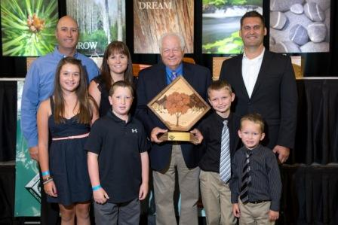
2013 National Outstanding Tree Farmer of the Year
“It’s been tremendous to be part of the Tree Farm’s growth and evolution,” said Arington’s daughter, Lisa.
“Dad started something that grew out of a passion he had – respect for the land and the desire to make it better for the future.
This land ethic is instilled in us and we embrace the responsibility to instill it in our children, the next generation of caretakers.”
Notes:
Personalize:
Insert your own photos, Tree Farm background, etc.
What makes you the authority to speak about ATFS? Why should people listen to you regarding Tree Farm?

Slide 3
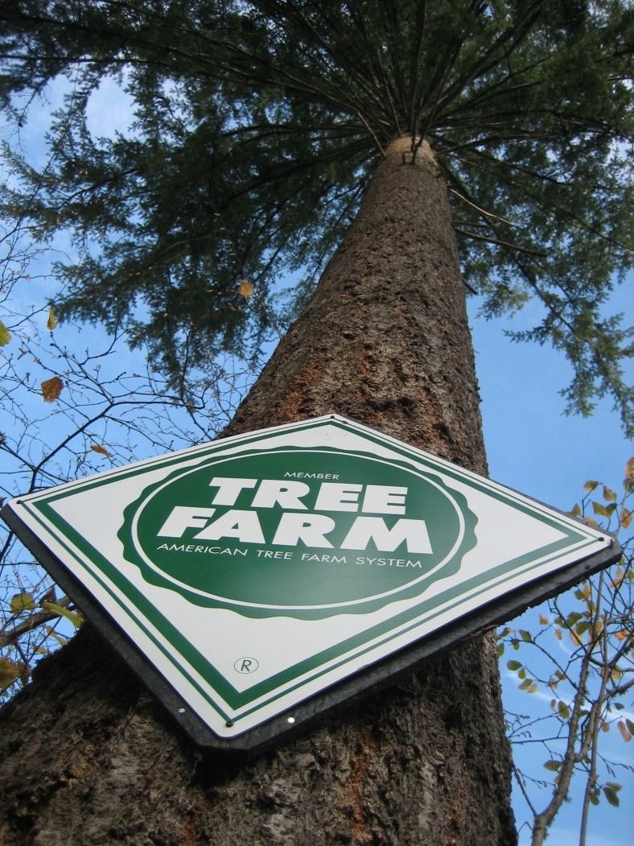
Agenda
Importance of Family Forests
Why ATFS?
ATFS Tools and Benefits
Next Steps
Notes:
Message:
This presentation is designed to cover these four main topics:
Why are family forests important?
What makes ATFS the best way to grow sustainable forests?
What are some of the tools and benefits that ATFS provides?
What are some of the next steps you can take?
During the presentation, you will be encouraged to share your own story and opinion about your experiences with ATFS
At the end of the presentation, we will discuss some next steps for you to take and have some time for questions

Slide 4
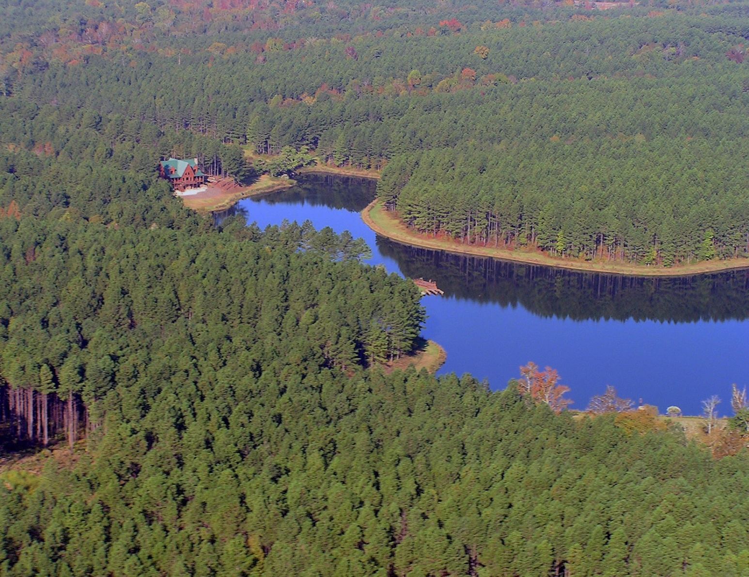
Where do you fit in?
Notes:
Message:
Family forest owners own more of America’s forest land than the federal government - land that provides communities with an abundance of clean water, fresh air, wildlife habitat and local jobs.
The responsibility of protecting our natural heritage does not come without its challenges, and ATFS is here to help you manage these challenges in order to create valuable opportunities for wood, water, wildlife and recreation.
Facts:
There are approximately 22 million family forest owners in the United States.
These family forest owners are responsible for approximately 35% of America’s forest land.
By comparison, the U.S. government owns approximately 33% of our nation’s forest land.
Interaction:
Ask a trivia question to begin the slide. For example, “Who here can tell us how many family forest owners are in the United States?”
Ask participants to name some of the challenges they have faced. Use a flip chart or white board to write down these challenges. This will transition to the next slide. For example, “Would anyone here today like to share with the group some of the challenges you have faced and/or overcome as a family forest owner?”

Slide 5
Perfect Storm
TAXES
Notes:
Message:
Factors such as increased taxes, natural disasters, invasive species, aging owners and a disconnected younger generation all come together to create a perfect storm of challenges facing family forest owners.
The American Tree Farm System strives to provide the tools and resources that you need to meet these challenges head-on today and into the future.
Personalize:
Reference some of the challenges mentioned in the previous slide.

Slide 6
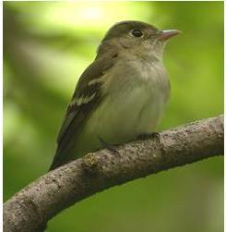
Why is your forest important?
25% of clean water originates in private forests
60% of all at-risk species rely on private forests
92% of wood and fiber comes from private forests
Photo by Mike McDowell
Notes:
Message:
Forest ownership has many benefits to private landowners (weekend retreat, family heritage, personal income, etc.), but there are so many people out there who do not realize the public benefits that come from family forests.
If you care about having clean water in your community, providing habitats for at-risk and native species, and access to local renewable resources, you should care about private forests.
Tips:
Avoid reading the slide directly.

Slide 7
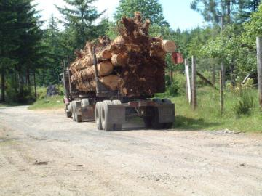
Why is your forest important?
2.8 million people nationwide are employed by forestry and related industries.
1,000 acres of private forests supports eight (8) good-paying jobs.
Notes:
Message:
Anyone who cares about job creation, especially rural and local jobs, should care about private forests.
As a landowner, you are doing your part to support millions of forestry-related professionals.
Closing Transition:
Private forests provide multiple public benefits, but what about you and your legacy?

Slide 8
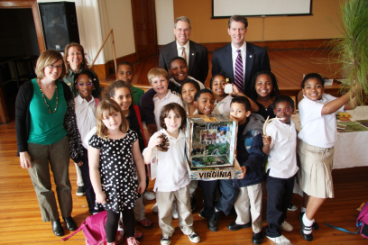
Why is your forest important?
Trees make fruits and nuts Pretty springtime buds blossom Leaves give food to trees
Haiku by 1st Grade student
Richmond, Virginia
Notes:
Message:
Exercising good stewardship on your land and designating your woodlands as a “Certified Tree Farm” or a “Certified Family Forest” shows your dedication to good stewardship.
As the owner of a Certified Tree Farm, you are setting the tone for future generations of good stewardship.
Interaction:
“Why is your forest important to you?”
“If you are not a landowner, why is it important to you that ATFS continues to protect forests?”
If no one answers, offer your own story or “One of the things I hear the most from Tree Farmers is…”
Closing Transition:
Reference some of the suggestions offered for why forests are important
Ask hypothetically, “What makes the American Tree Farm System the best way to grow stewardship on my land and protect this natural heritage for the future?”

Slide 9
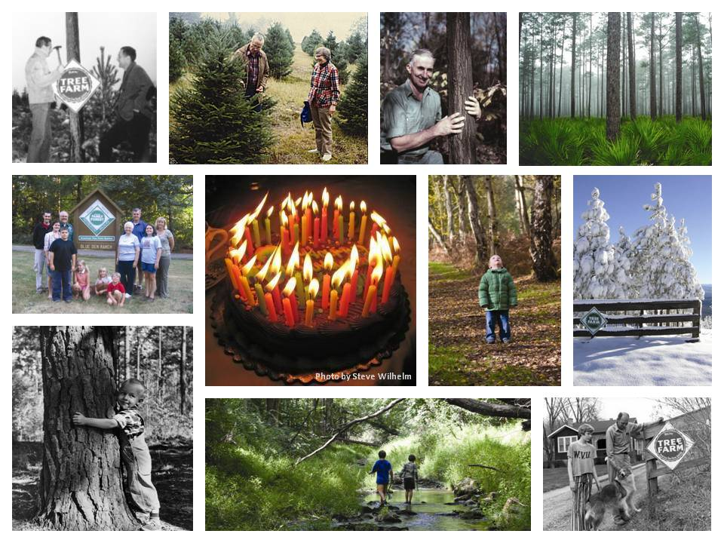
Notes:
Message:
Over the past 70 years, the American Tree Farm System has positioned itself as a strong, vibrant, and well-respected leader in the global forestry arena. Through the years, ATFS has developed its powerful voice in Washington, DC by focusing on the specific needs and challenges that face America’s family forest landowners, and ATFS continues to develop and adapt the tools Tree Farmers need in order to keep their forests healthy and productive.
Facts:
ATFS is the oldest sustainable woodland system in America.
On June 12, 1941, the nation’s first Tree Farm was dedicated near Montesano, Washington.
Family forest owners in the American Tree Farm System manage nearly 26 million acres.
Tips:
Use the facts to create a trivia question in order to engage your audience.

Slide 10
Notes:
Message:
Our nation’s demand for wood will never go away. The American Tree Farm System is there for you now and for the future – to give you the tools you need in order to carry out your important work on the ground that will protect America’s forest heritage for many generations to come.
Transition:
Let’s talk about some of the tools ATFS makes available…

Slide 11
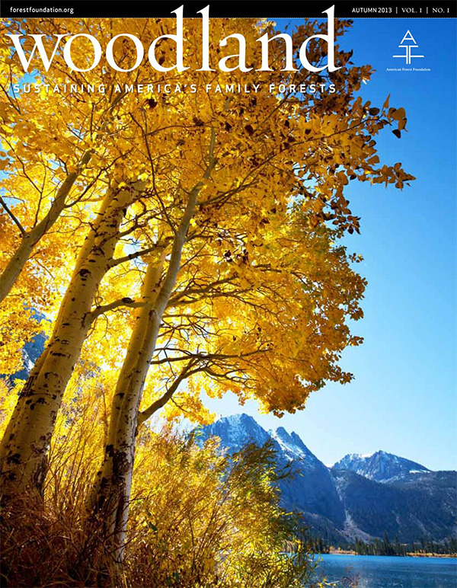
Tools
Publications
Notes:
Message:
ATFS is committed to getting Tree Farmers, volunteers and partners the information they need through our various publications – Woodland Magazine, Sightline and Sightline Express Newsletters.
We are not only giving you the tools you need, but we are also giving foresters and volunteers the tools they need to help you carry out your work on the ground.
These publications offer practical tools, programmatic information, and stories.
These tools are your guide to sustaining family forests, and these publications are constantly improving to meet the needs of Tree Farmers.

Slide 12
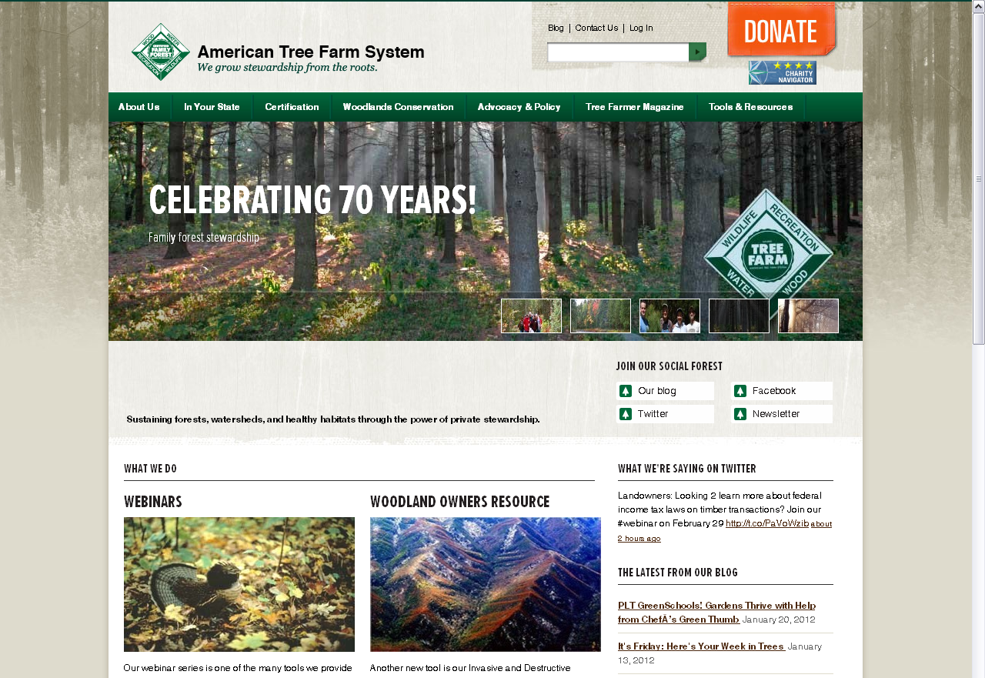
Tools
American Tree Farm System Website
www.treefarmsystem.org
Notes:
Message:
The American Tree Farm System website is a one-stop shop for educational tools and resources and information about the program.
Browse our services directory to find contact information for local resources (foresters, government agencies, etc.), participate in one of our many webinars, learn about our work with Congress on issues facing Tree Farmers, share your Tree Farm story with our broad network, and much more.
Transition:
For the woodland owner who understands the value of good stewardship and sustainability, this is a great tool. However, there are millions of other woodland land owners out there who are at the beginning stages of sustainable forest management.

Slide 13
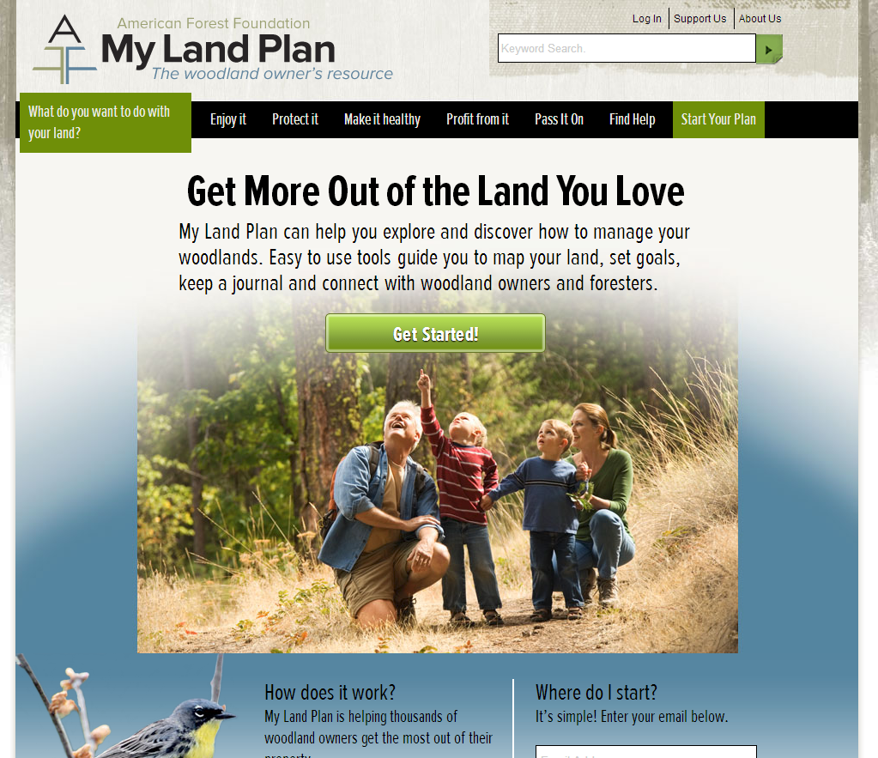
Tools
My Land Plan Website
www.mylandplan.org
Notes:
Message:
The My Land Plan website is a tool for woodland owners who are just starting out in their quest for knowledge regarding sustainable forest management. We have designed this online resource to provide these landowners with a way to learn more about their woods, identify forestry professionals in their community, set goals and begin their legacy of woodland stewardship.
Transition:
Of course, this is only a sample of the tools and resources ATFS has to offer, and we are always developing new tools and thinking of new ways to support the work that our Tree Farmers and volunteers do on the ground to keep forests healthy and productive.

Slide 14
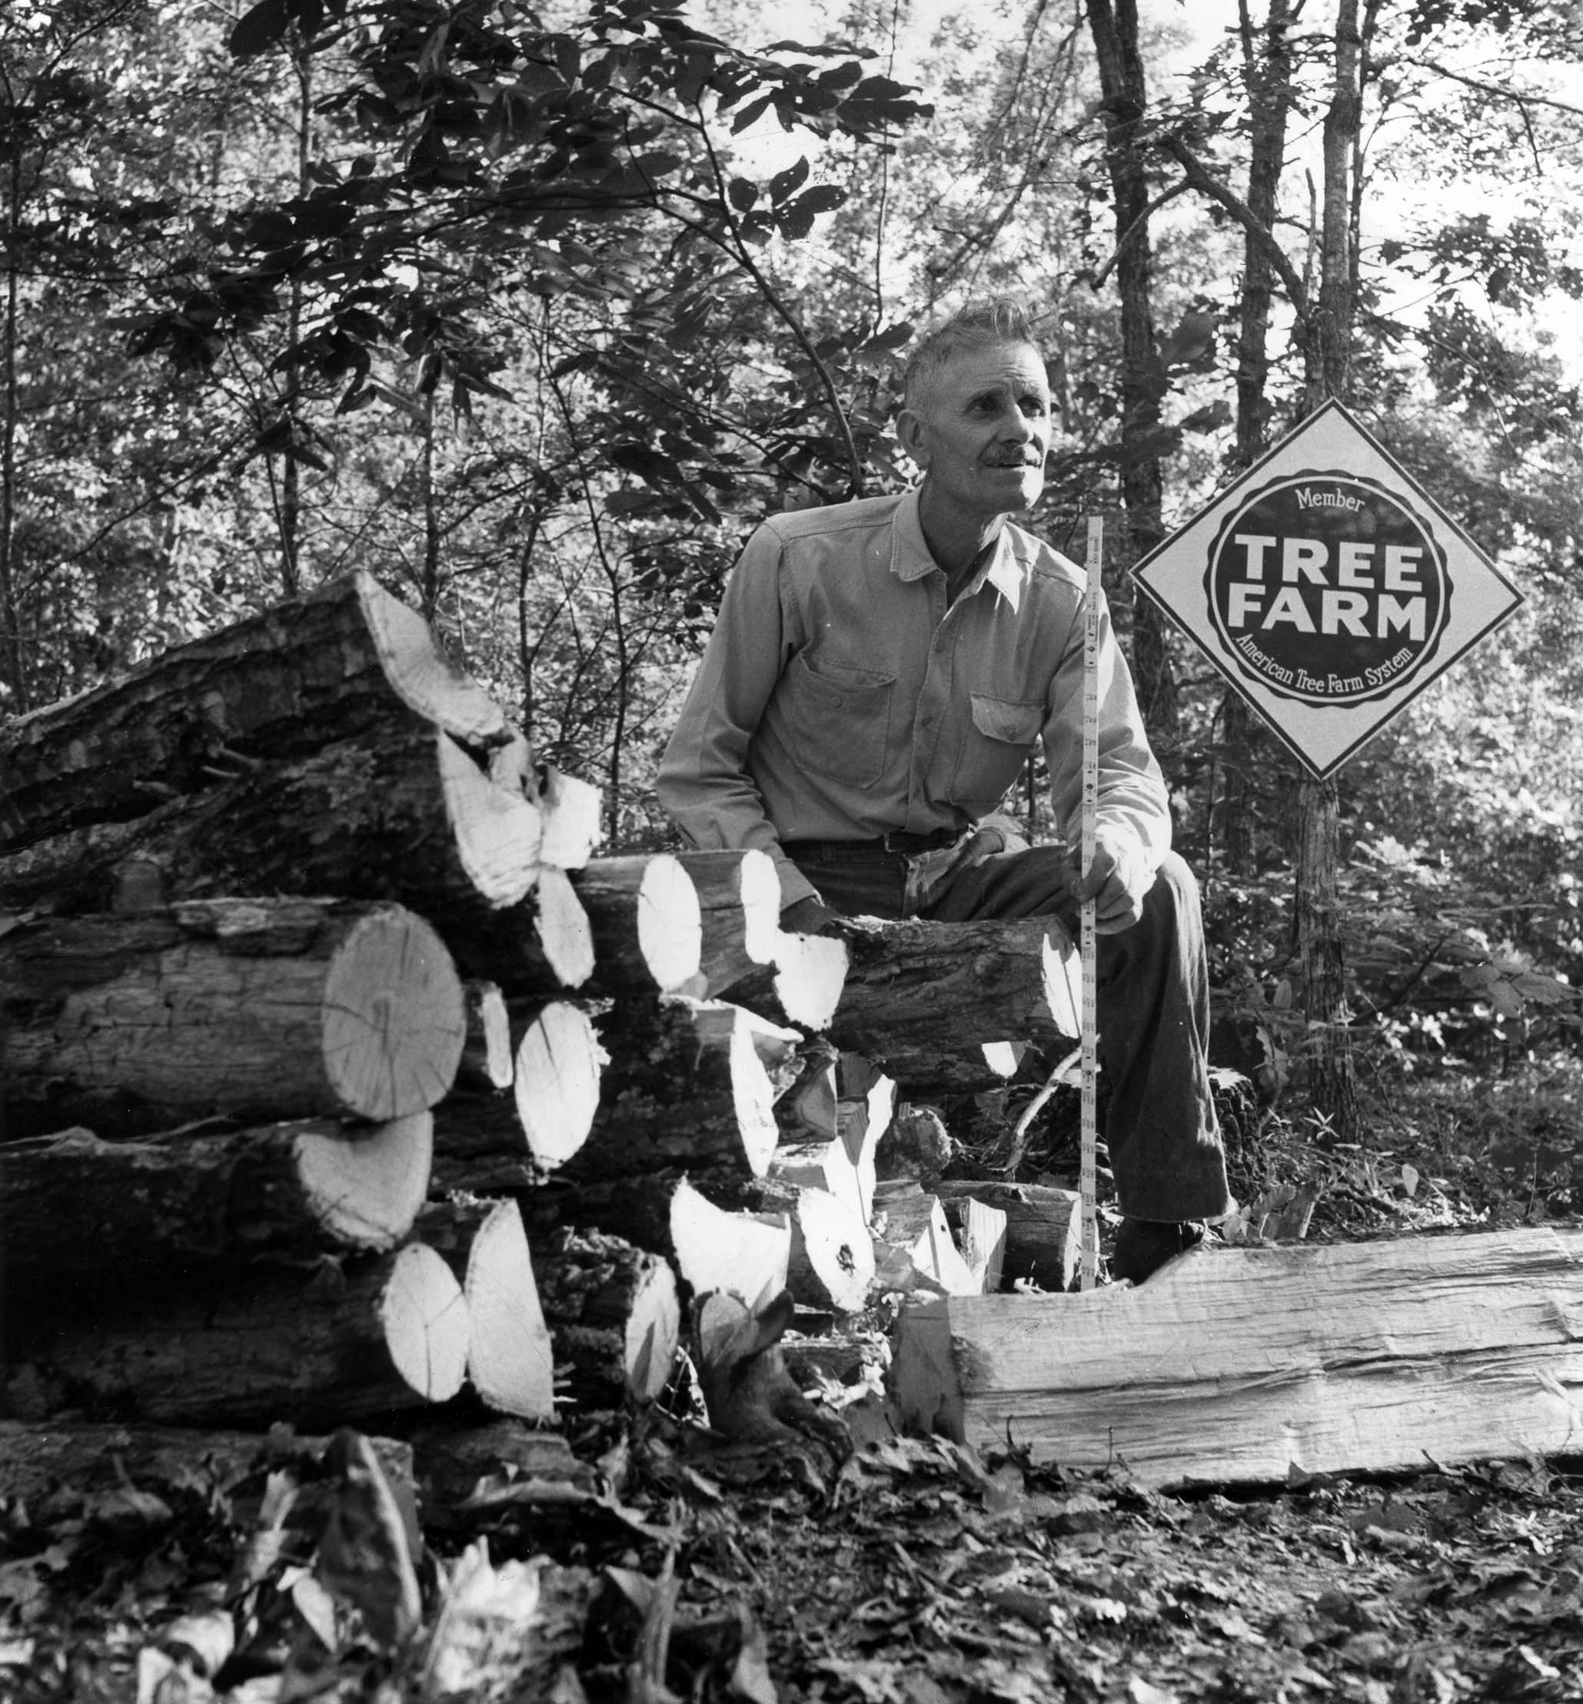
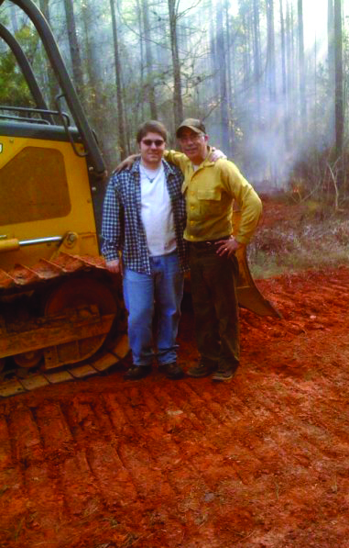
On the Ground
Notes:
Message:
For a Certified Tree Farmer to reach his or her goals, it takes a lot of hard work on the ground.
The American Tree Farm System supports a vibrant network of professionals who deliver tools and support the on the ground work that our Tree Farmers do in order to improve forest conservation.

Slide 15
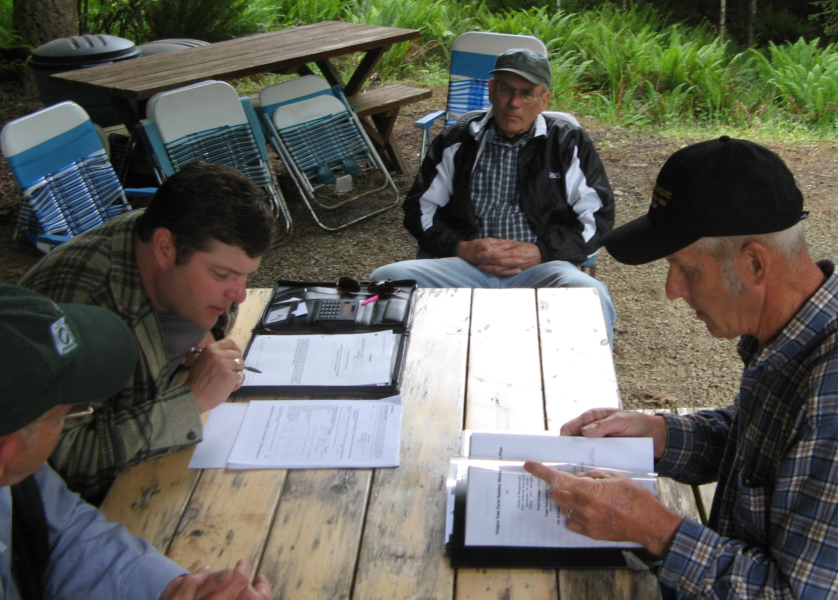
On the Ground
Notes:
Message:
Our network core of trained inspecting foresters links you one-on-one with an expert who will guide you in developing your management plan, assist in setting up goals for your property, conduct inspections and become your on-the-ground ally.
Facts:
Our network of over 4,500 volunteers spread across 42 states, along with our infrastructure of professional foresters, enables woodland owners to meet their on-the-ground stewardship objectives with confidence.

Slide 16
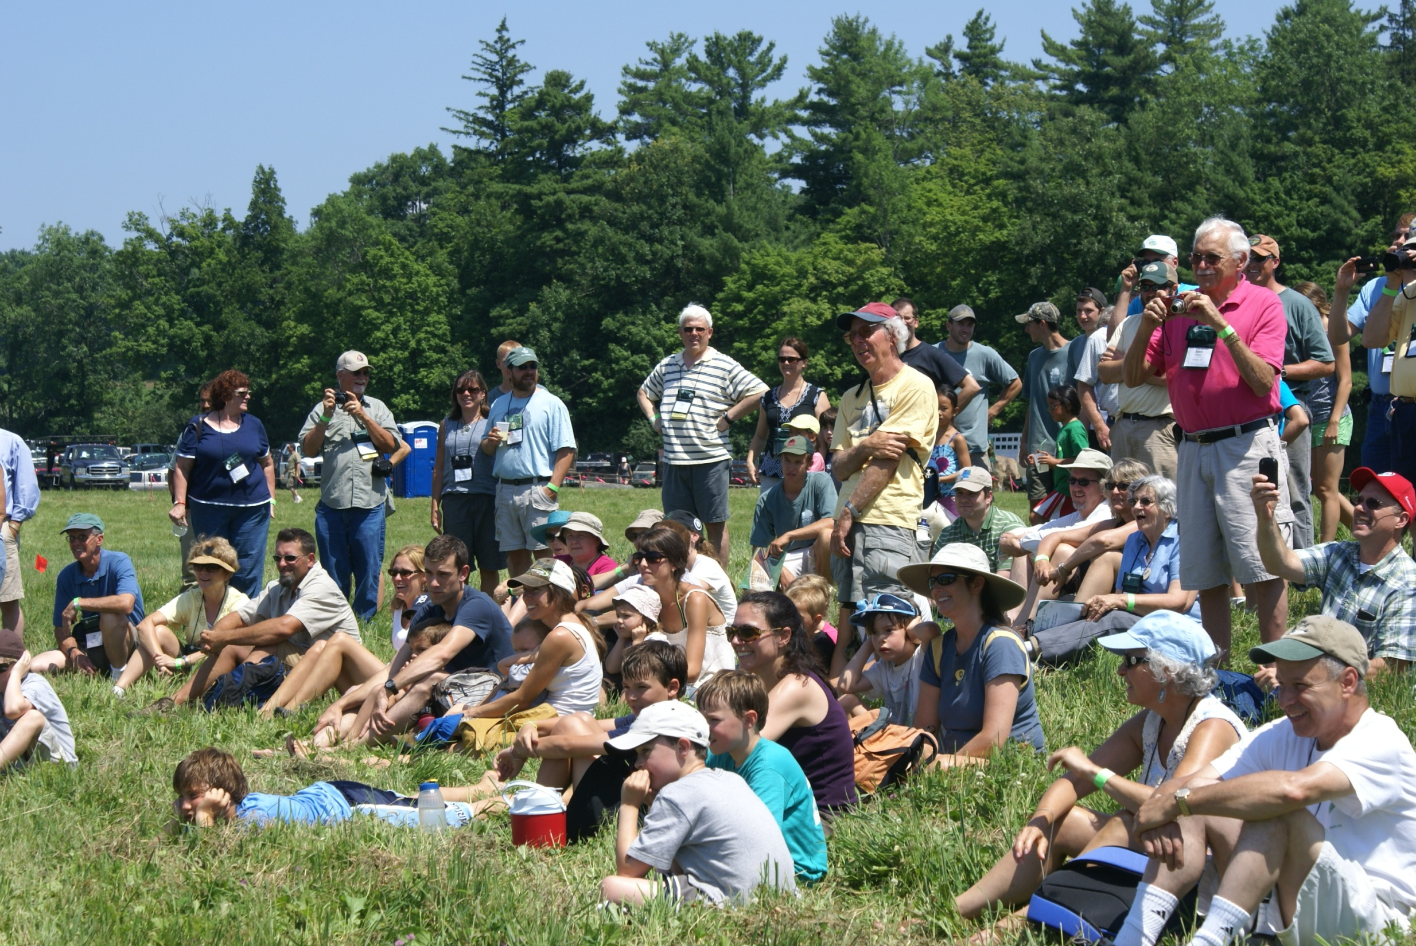
On the Ground
Notes:
Message:
ATFS state committees and volunteers work locally to provide on-the-ground resources that Tree Farmers need in each state.
Access to ATFS-supported field days and workshops gives Certified Tree Farmers the educational tools and validation they need to know that they are doing right by their land.
Personalize:
Mention an upcoming event in your state.
Transition:
The future of our forest stewardship depends on what we can accomplish on the ground today.

Slide 17
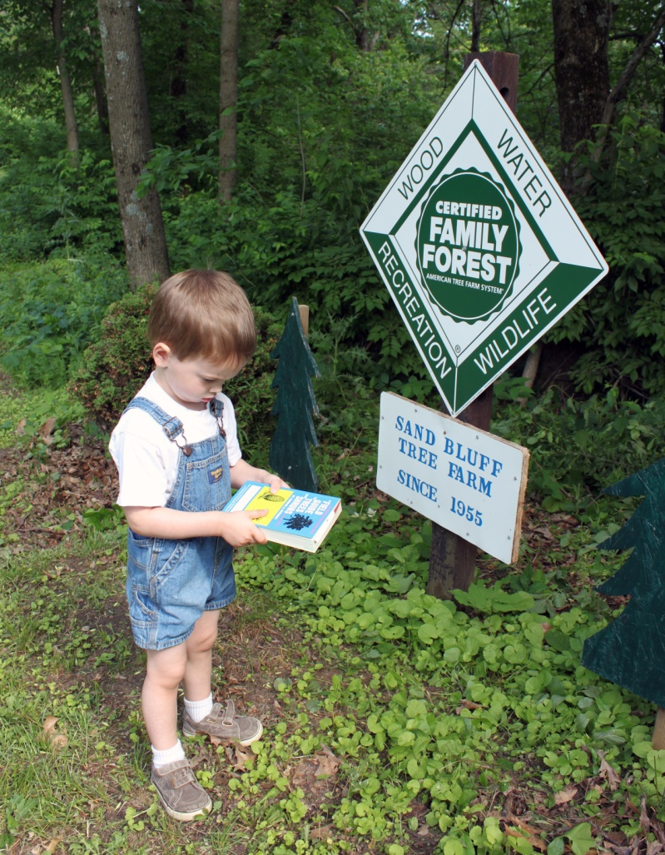
Future
Notes:
Message:
The American Tree Farm System represents the interest of woodland landowners to industry, trade associations, and federal policymakers.
We are their voice in Washington, DC advocating for policies that will support today’s network of forest stewards, as well as the next generation.
Our Grassroots network is composed of dedicated landowners and volunteers who reach out to their representatives both at home and on Capitol Hill regarding the pressing issues facing private woodland owners.
Personalize:
Highlight your state’s accomplishments here

Slide 18
Future
Fix it for Good
Estate Taxes
Forests in the Farm Bill
Markets
Wood
Ecosystems
Notes:
Message:
It doesn’t matter if you are an industry-minded Tree Farmer looking to harvest your product on a regular basis or if you are the owner of a small woodland nature retreat – ATFS works on issues important to all family forest owners.
Facts:
In 2011, Secretary Tom Vilsack and the U.S. Department of Agriculture (USDA) developed a new green building strategy to promote wood products as an environmentally preferable building material.

Slide 19
Notes:
Interaction:
Use this slide to garner discussion about the tools and resources you have just discussed.
You may want to use the following prompt:
We have talked about the tools ATFS has developed for landowners, our networks of professionals and volunteers working on the ground, as well as the work we are doing in Congress to protect future generations of woodland landowners, but what are some more resources that we can develop or actions that we can take in order to help you develop and sustain well managed forests?
Speaker should record answers and report back to ATFS national office.
Transition:
Thank everyone for their input and let them know that you will share their ideas with the ATFS national office.
Now let’s talk a little bit more about what’s behind the sign…

Slide 20
What’s behind the sign?
Notes:
Message:
This image isn’t just a logo on a sign that you can post on your Tree Farm. Being a certified Tree Farmer with ATFS offers you the distinction and validation you need to know that you are doing right by your land. Not just anyone can purchase and post this sign on their property.
Distinction
When you become certified with ATFS and post the green and white sign on your property, you distinguish yourself as an ambassador for well-managed private forests and as someone who takes their forest heritage seriously. This sign symbolizes to your community your commitment to good stewardship.
Validation
Our dedicated and network of landowners, volunteers, and professionals work behind the sign to give you the confidence you need to know that you are doing right by your land.
ATFS certification is internationally recognized and meets third-party standards.
Interaction:
If you are already a certified Tree Farmer, how do you explain the value of belonging to the American Tree Farm System to someone who doesn’t know anything about ATFS?
Personalize:
You can leave both logos on the screen or delete the one that your state does not use. If you leave both logos, be prepared to explain the difference.
You can also use this slide to briefly talk about eligibility requirements.
How do our tools and resources, our on-the-ground network of professional and volunteer supporters, and our work on Capitol Hill match up with your own values?
(Ask audience to reflect on their values and goals and how ATFS can help to achieve them.)

Slide 21
Certified Tree Farmers
Stay Certified
Know your Tree Farm number
Join our Grassroots network
Thank your Forester
Share your experiences
Notes:
Message:
Let’s talk about some of the next steps and opportunities you can take to enhance your experience with the American Tree Farm System.
Talking Points:
Stay Certified
Use the Standards for Certification as a guide to good forest management
Review your management plan annually
Share your experiences
Ask people to think about how the Estate Tax will affect their family. If they have a story to share, listen!
Personalize:
Remove this slide if there are no Certified Tree Farmers in your audience.

Slide 22
Interested Woodland Owner
Visit www.mylandplan.org
Talk to your Forester about your values and goals for your land
Reach out to your state’s Tree Farm Committee and get certified
Notes:
Message:
Let’s talk about some of the next steps and opportunities you can take to enhance your experience with the American Tree Farm System.
When you’re ready and interested, reach out to your state’s committee and get certified.
Personalize:
Remove this slide if there are no interested woodland owners in your audience.

Slide 23
Foresters
Become an ATFS Inspector and grow your business
Get listed in our Services Directory
Reach out to more landowners through your state’s Tree Farm Committee
Share the benefits and values of ATFS with your community
Notes:
Message:
Let’s talk about some of the next steps and opportunities you can take to enhance your experience with the American Tree Farm System.
Personalize:
Remove this slide if there are no foresters in your audience.

Slide 24
National Tree Farmer Convention
July 25 – 27, 2013
Minneapolis, Minnesota
www.treefarmsystem.org/
tree-farmer-conventions
Notes:
Message:
One thing that EVERYONE can do is make plans to join us for this year’s National Tree Farmer Convention.
The National Tree Farmer Convention is a great opportunity to come together with other tree farmers, volunteers, and industry professionals from all across the country to network and hear great stories; learn new tools and tips to use as a woodland landowner; and have fun with your own family and the American Tree Farm System network.
This year’s convention will be…
Personalize:
Make sure you are advertising this year’s Convention.
Mention any upcoming field days your state is planning.

Slide 25
Questions?
www.treefarmsystem.org
(Your state’s website.)
(Your name and contact information again.)
Notes:
Important Note to Speaker:
Don’t end on this slide! Be sure to end on either the next slide (quote) or the video slide (if you have video capabilities).

Slide 26
“We’ve earned that sign by working very hard managing our forest, and we want to show it off.” -Janet Olver, Pennsylvania Tree Farmer
Notes:
Message:
This is the kind of thing that you will hear every day from Tree Farmers.
Everyone has their own special connection to the land, their own story to tell, and the American Tree Farm System is there to make sure that your story is heard and that everyone understands the value of ATFS.

Slide 27
Notes:
Message:
Ask people to stick around for a video about what ATFS means to landowners.
Be sure to test this slide BEFORE your presentation to ensure video playback!!! If the video doesn’t play, your options are:
Contact Sara Anrrich ahead of time to request the DVD.
Allow for internet access in your presentation room and show the video directly from the ATFS YouTube page. Copy/paste this URL into your web browser: http://www.youtube.com/watch?v=VyOe5NIaG64&feature=plcp

