Slide 1
Keep the Forest In the Family
Melissa Moeller
Public Affairs Manager
American Forest Foundation

Slide 2

Here Today. Gone Tomorrow?
Most of America’s forests are owned by families, not the federal government.
And most forest owners don’t make six figure salaries.

Slide 3
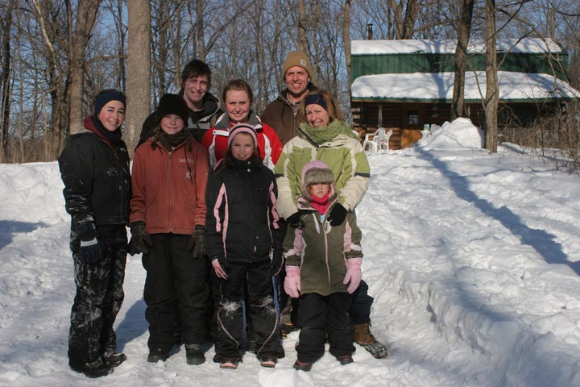
The Threat is Real
If the estate tax reverts back to 2001 levels, more families and many more acres will be threatened.
Notes:
Read “WI Tree Farmer” story

Slide 4
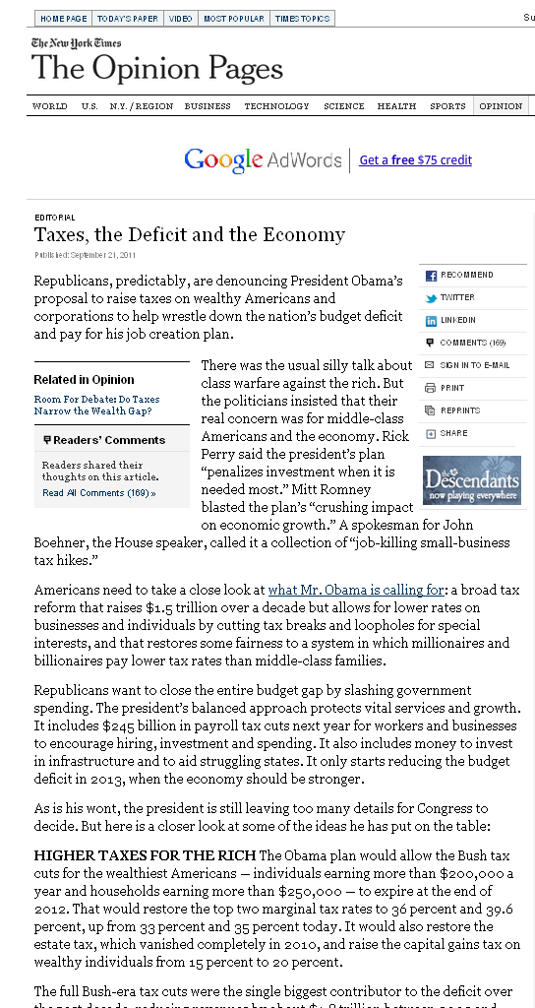
Public Perception
“Tax Cuts for the Wealthy”
“Estate Tax only affects small numbers of Americans.”

Slide 5

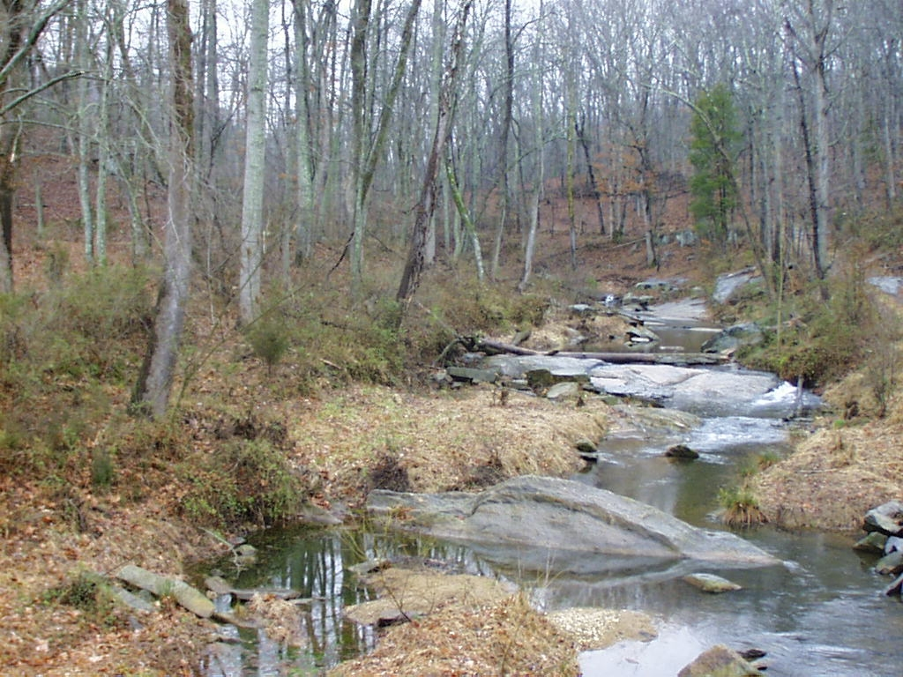
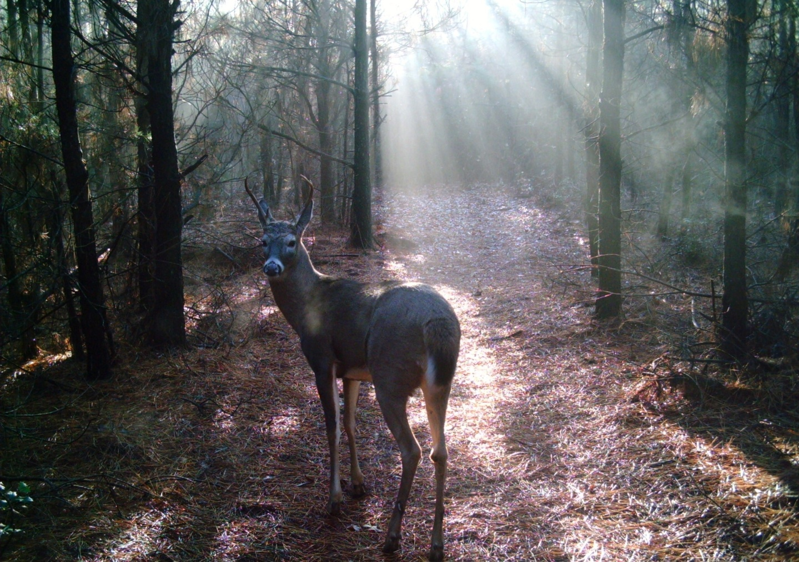
When the estate tax hits…
Notes:
The “Victims” may not be obvious - Water

Slide 6
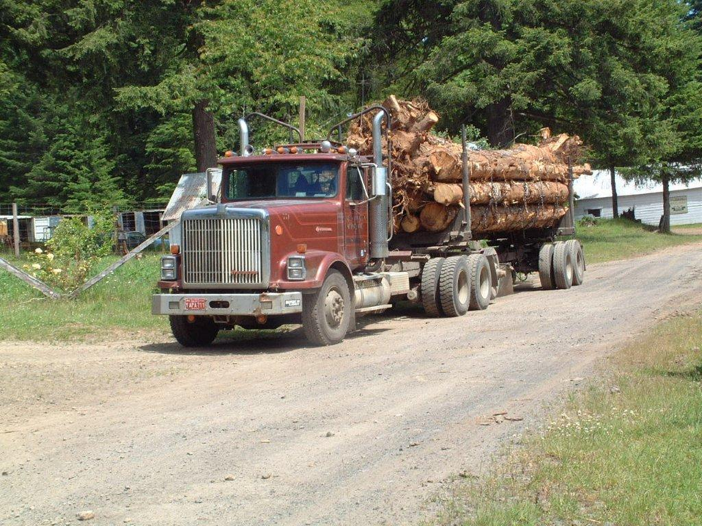
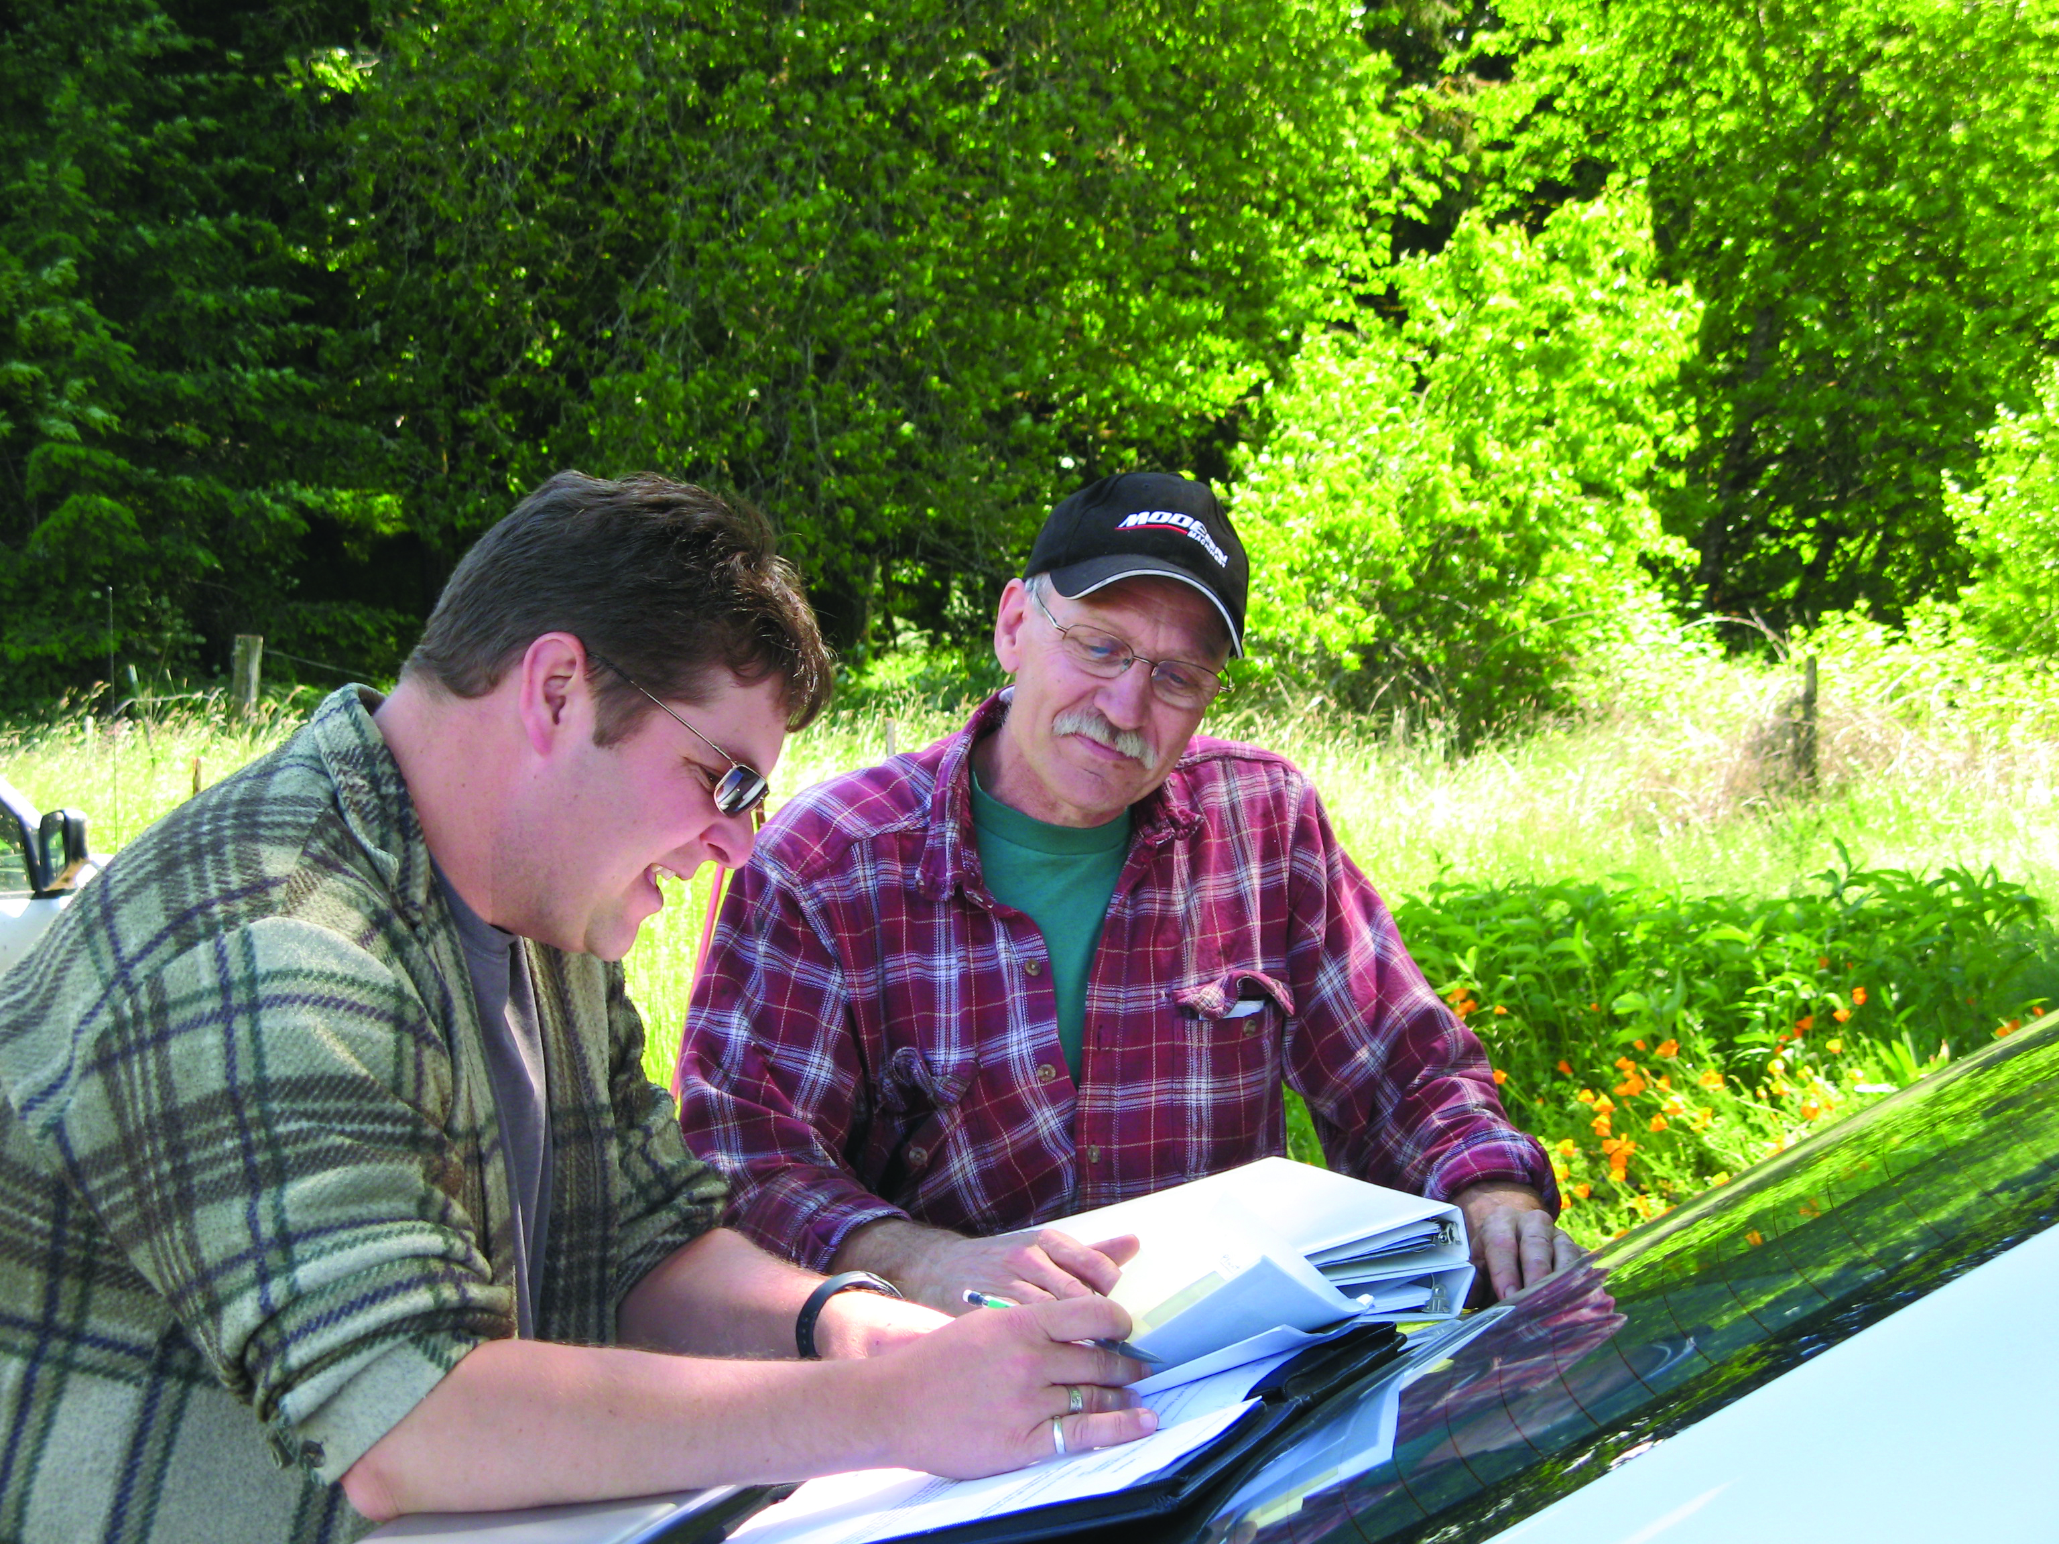
Unlikely “victims”

Slide 7
How do we change the conversation?
We need a fix to the estate tax
that works
for family forest owners.

Slide 8
Current Estate Tax Situation
Two year “fix” expires December 31, 2012
  $5 million
  35%
No Congressional Action?
  2001 levels
  $1 million
  55%

Slide 9
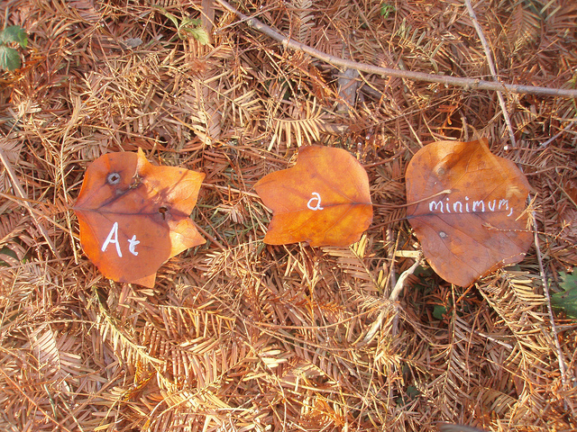
Congress should…
Extend the current estate tax levels--$5 million exemption level, 35% tax rate.
Fix problems with special use valuation so forest owners can use it to reduce their estate tax burden.

Slide 10

Some Problems with Special Use
Penalties for timber harvesting
Complicated and difficult to use
Requires some advance planning

Slide 11
Keep the Forest in the Family Act
“Keep the Forest in the Family Act”
  Fixes the timber harvesting penalties for forest owners who have a Forest Stewardship Plan (or equivalent) or are Third-Party Certified (i.e. ATFS)
  Calls on the USFS and IRS to address other complications for forest owners

Slide 12
What are we asking Congress to do?
Extend the current estate tax levels (adjusted for inflation)
AND
Pass the “Keep the Forest in the Family Act
These two actions combined will go a long way to lessening the estate tax burden for forest owners.

Slide 13
Political Realities
Election year
December action
Divided House and Senate
Increasing partisanship
Public perception of “tax cuts for the wealthy”

Slide 14

But…
If you’re not at the table, you’re on the table.
We need to build strong
Congressional champions
now who will include our
estate tax fix in a larger
tax package.

Slide 15
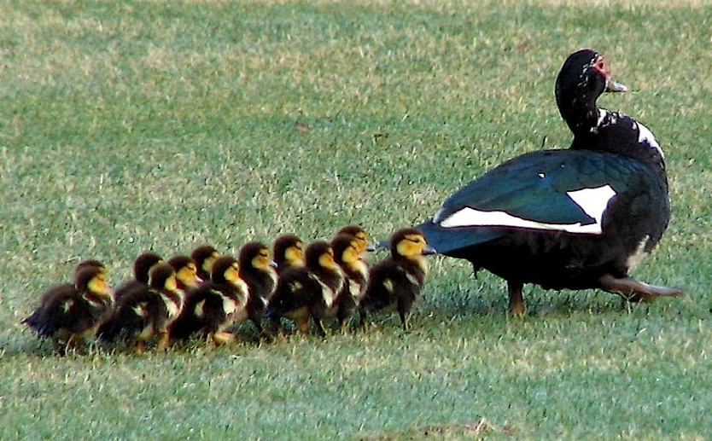
Getting our ducks in a row…
Collecting stories
Research for stronger
data to make our case
Building relationships
on Capitol Hill
Building coalitions of organizations
Preparing for a grassroots, lobbying, and local media push around the estate tax

Slide 16
What makes a campaign successful?
Having good information?
A well-connected lobbyist?
Thousands of emails and messages sent to Congress?
Dozens of stories in the news?
Support from long list of organizations?

Slide 17





Who Does Congress Listen to?
But 90% Rate you as #1

Slide 18

Some Common Myths
My issues aren’t important
  You’re a constituent
They don’t want to hear from me
  90% rate you as #1
I’m not a good spokesperson
  Who better?
DC Staff have it covered
  Grassroots= Spinach

Slide 19
Becoming an advocate
Step 1:
Visit www.familyforestaction.org and send a simple email to your U.S. Representative and Senators.
Simple and quick way to take action
Does this really make a difference? Yes!

Slide 20
What’s next?
Step 2:
Let others know about the Tree Farm grassroots network—get your family, neighbors, and other Tree Farmers in your state to join.
One message makes a difference, but 10 messages get more notice.

Slide 21
Share your actions with me
Email me and let me know you took action—and any feedback you might get!
A coordinated advocacy effort can be more effective.
We may call on you in the future!
Melissa Moeller: mmoeller@forestfoundation.org

Slide 22

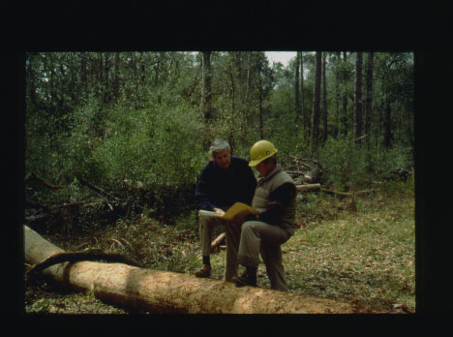
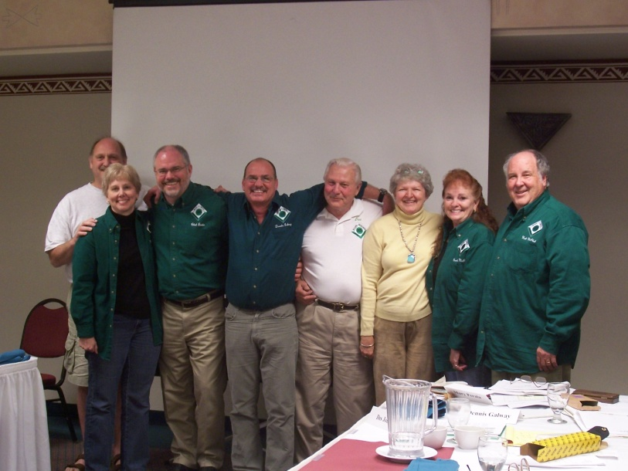
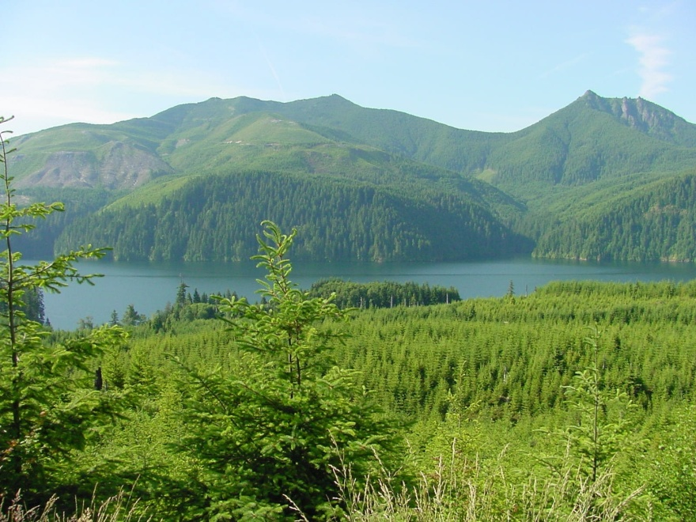
Connect Back Home

Slide 23
Make An Appointment

Slide 24
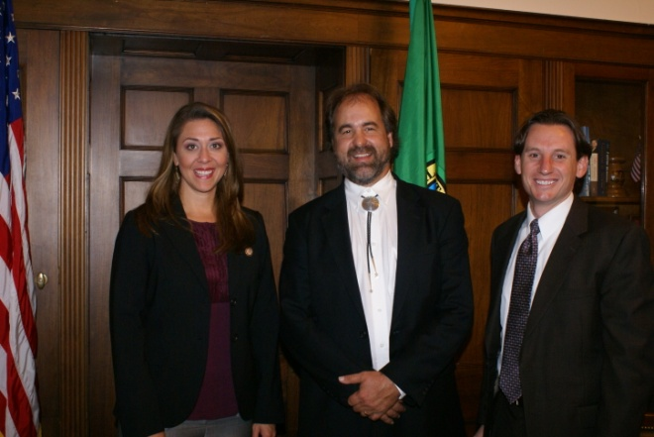


Staff are ESSENTIAL
Expect Youth
Gatekeepers and Experts
Turnover
One of Many Issues

Slide 25
You Don’t have to be an Expert

Slide 26

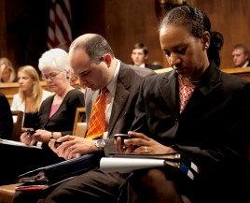

Avoid Information Overload

Slide 27
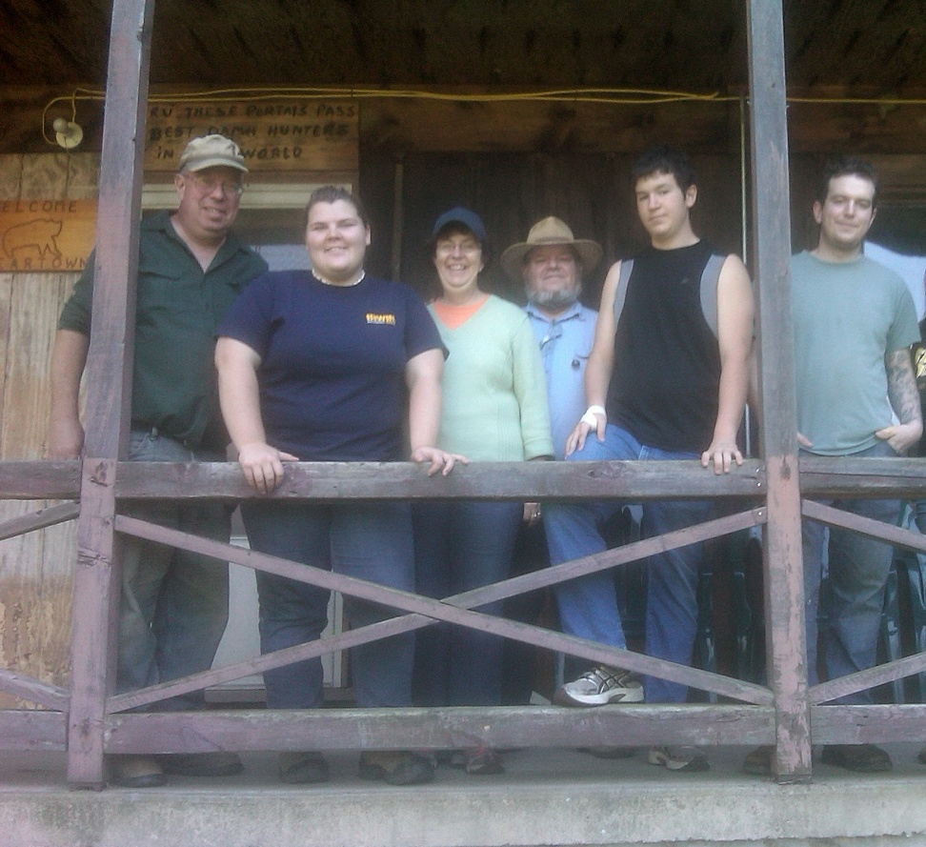
Tell Your Story

Slide 28
Have an “Ask”
What do you want the Member to do for you?
Cosponsor “Keep the Forest in the Family Act”
Visit our Tree Farm
Remember family forest owners when the estate tax comes up!

Slide 29
Grassroots Get it Done
Join Tree Farm’s Grassroots Action Network.
www.familyforestaction.org
Talk with your fellow Tree Farmers.
Talk with your family and friends.
Talk with your elected officials.
Share your story.

Slide 30
Contact Info
Melissa Moeller
Manager, Public Affairs
202.463.2456
mmoeller@forestfoundation.org

